Slide 1


Insights
How casual members and annual members differ in terms of using Cyclistic bikes
conclusion
Overview
Hussain Bahieldeen

Slide 2
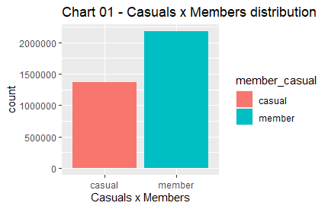
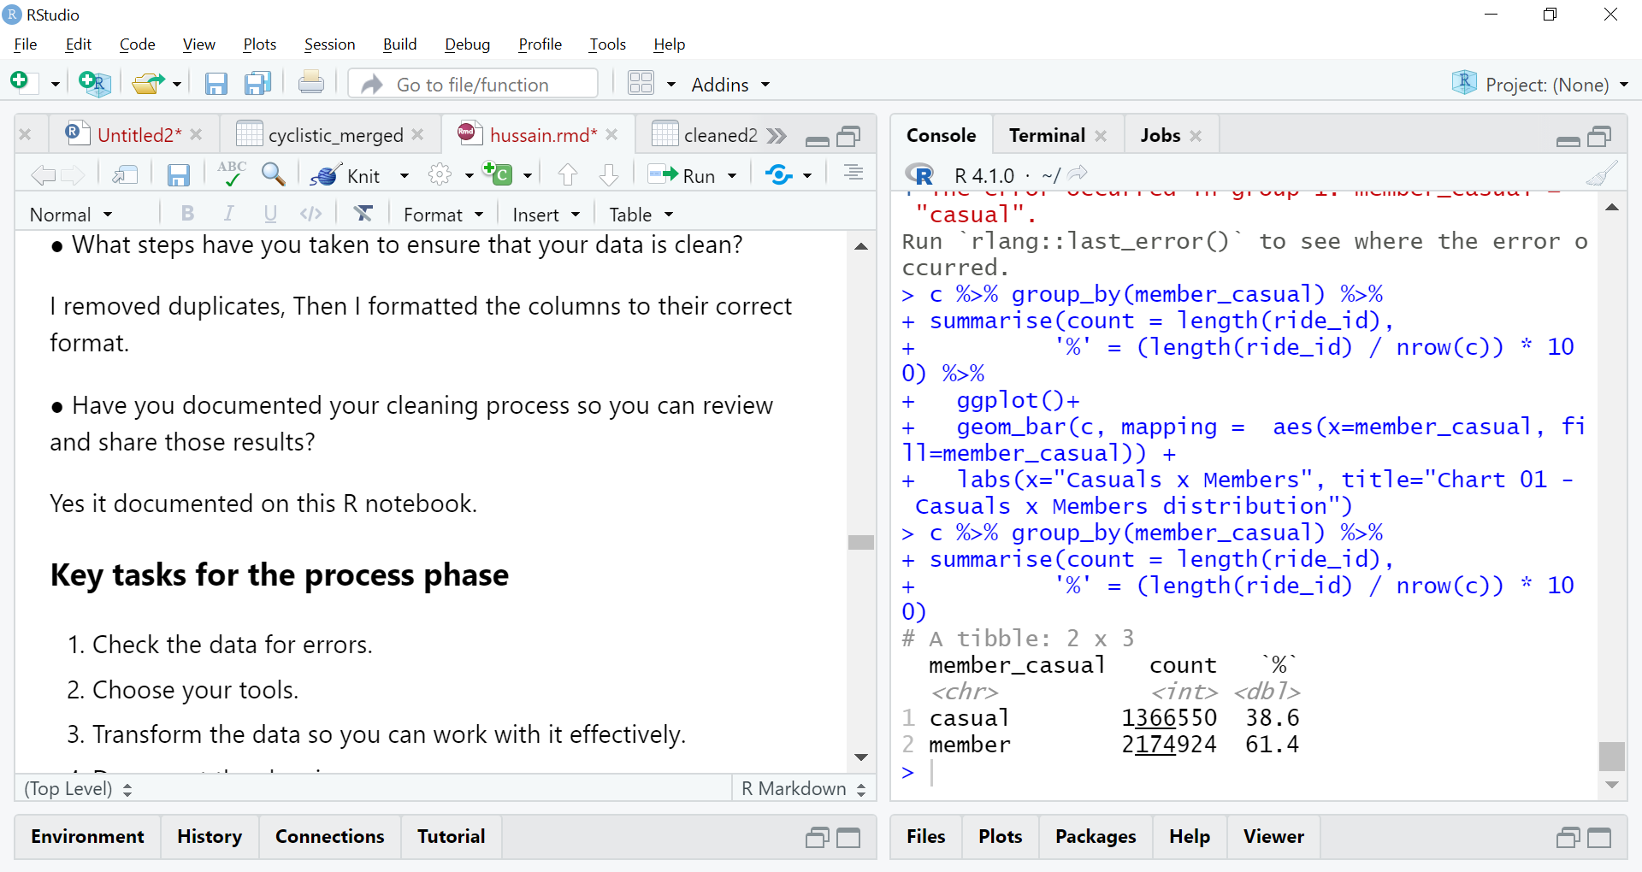
Casual Vs Annual members distribution
conclusion
Insights
Overview
As you can see Annual members are more than casual members and there percentage is 61 for Annual members and 39 for Casual members

Slide 3
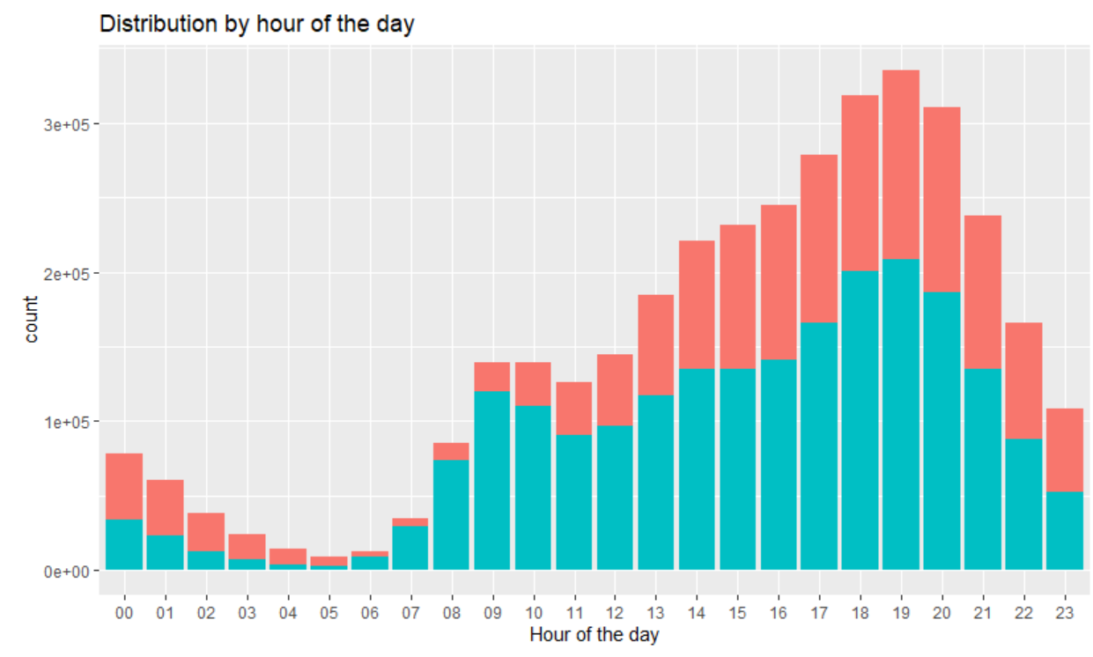
Time of the day with Increased demand for rides
Insights
conclusion
Overview
As we can see the demand for rides for casual members reaches its peak at 19-20 and the demand for rides for annual members reaches its peak at 19-21 as well. But generally there is a high demand starting from the afternoon for rides in both members types.

Slide 4
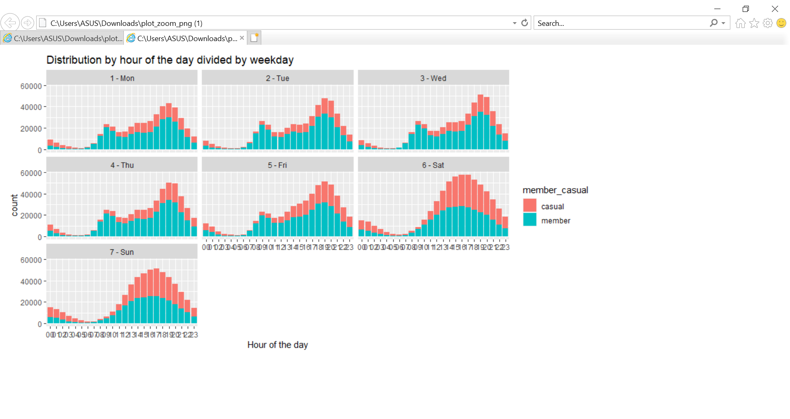
Time of the day with Increased demand for rides separated by days of the week
conclusion
Overview

Slide 5
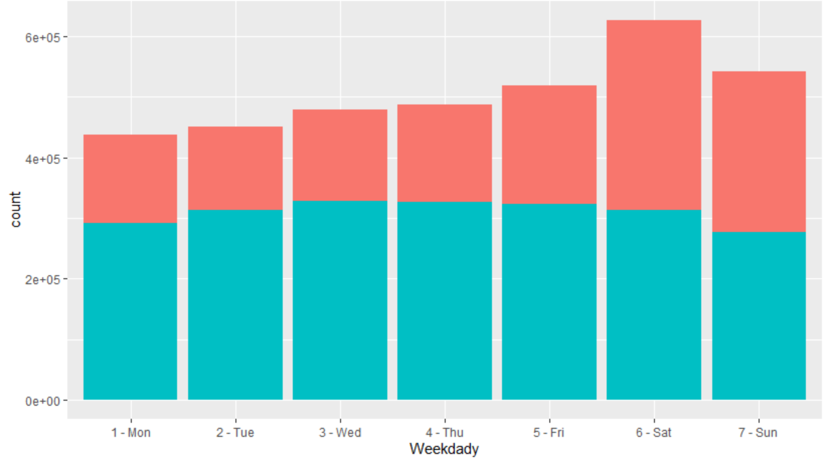
Day of the week with the most number of rides
conclusion
Overview
Insights
High volume of rides on the weekend.
Saturday has the biggest data points.
Casual members has more rides in the weekends compared to weekdays.

Slide 6
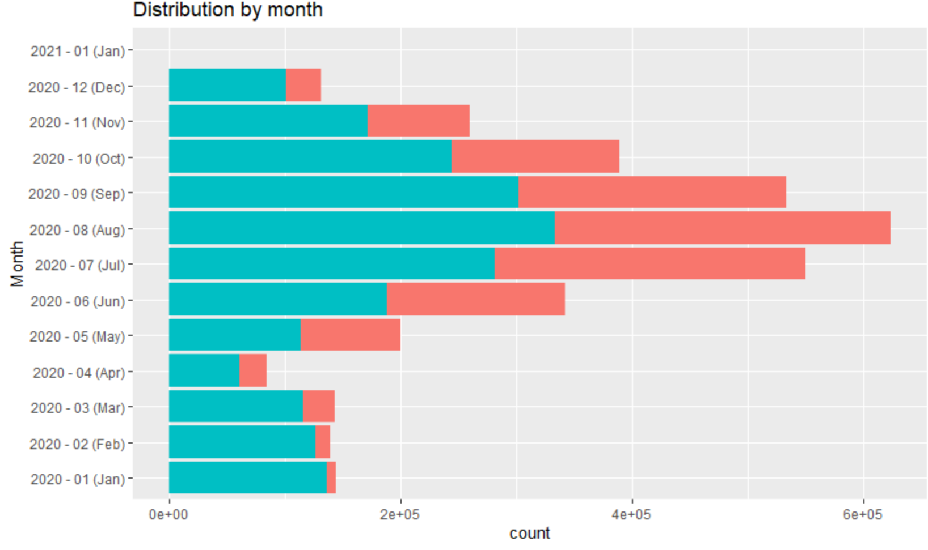
Period of the year with the most number of rides
conclusion
Insights
Overview
Temperature influences the number of rides.
The month with the biggest count of data points was August 623578 rides.
In all months we have more members' rides than casual rides.
Summer has the highest volume of data.

Slide 7
Summary of the insights about the data
Members may have the biggest volume of data, besides on saturday. On this weekday, casuals take place as having the most data points.
Temperature heavily influences rides, highest number of rides was during summer season.
Weekends have the biggest volume of casuals, starting on friday, a ~20% increase.
We have more members during the morning, mainly between 5am and 11am. And more casuals between 11pm and 4am.
There's a big increase of data points in the midweek between 6am to 8am for members. Then it fell a bit. Another big increase is from 5pm to 6pm.
During the weekend we have a bigger flow of casuals between 11am to 6pm.
Members have a bigger preference for classic bikes, 56% more.
Casuals have more riding time than members.
Riding time for members keeps unchanged during the midweek, increasing during weekends.
Casuals follow a more curve distribution, peaking on sundays and valleying on wednesday/thursday.
conclusion
Insights
Overview

